Slide 1

The 311 Analyzers
Christopher Chan, Lincon Chopra, Nino Alishvili, Rojina Dhikari

Slide 2


Introduction and background
We analyzed thousands of NYC 311 service requests to understand what actually drives city agency response times.
Our project developed a machine learning model that predicts whether a complaint will be resolved within seven days, helping identify specific bottlenecks in public services across different boroughs.

Slide 3
💡 Motivation of the Research Question
🏙️
Scale of 311 Requests
⏱️
Impact on Quality of Life
🎯
Early Delay Detection
NYC receives thousands of 311 service requests daily across different agencies and all five boroughs.
Delayed resolution negatively affects residents' quality of life and public service efficiency.
Predicting whether a request closes within 7 days helps identify potential delays before they escalate.
⚙️
Resource Allocation
🧠
Smart City Analytics
Understanding the key factors that influence closure time supports better operational planning.
Combining predictive analytics with public service insights enables smarter, data-driven city management.

Slide 4

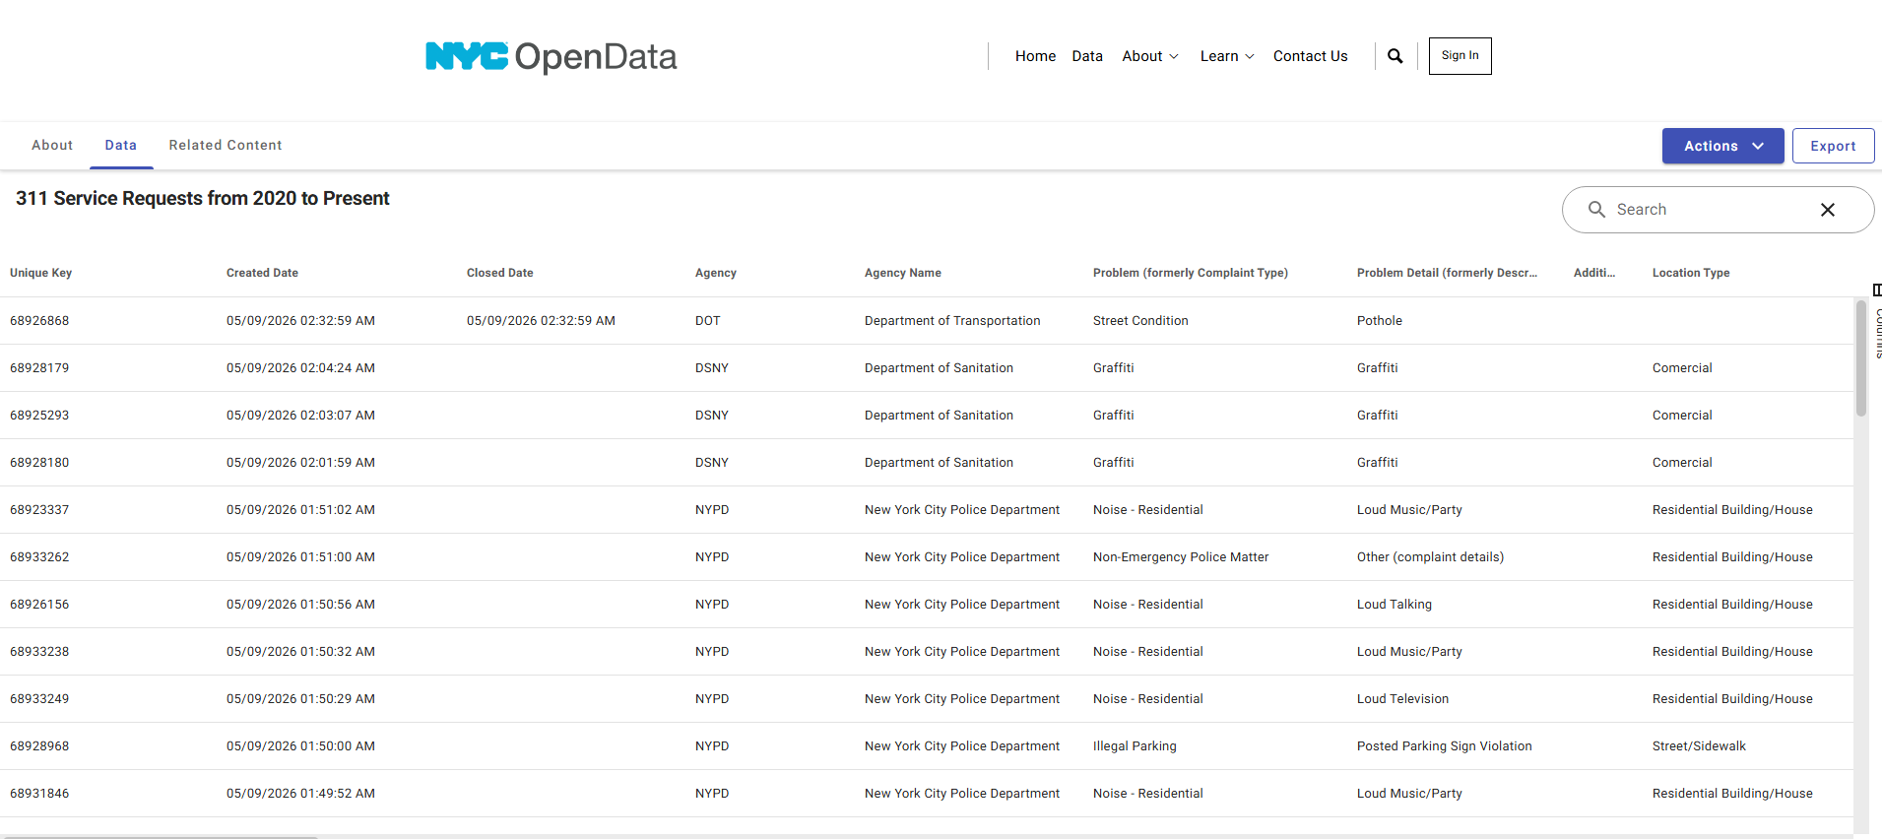

Dataset description and variable introduction
Data Sourcing & Scope: Leveraged the NYC Open Data Socrata API to analyze 311 service requests submitted between January 1, 2026, and April 30, 2026.
Key Predictive Features: Analyzed organizational (Agency), categorical (Complaint Type), and geographic (Borough) attributes to determine their impact on resolution speed.
Target Variable Definition: Engineered a binary classification target, "Closed Within 7 Days," to serve as a benchmark for municipal service efficiency.
Feature Engineering: Transformed raw timestamps into temporal features (Day of Week, Month) and calculated "Resolution Days" to quantify agency performance.
Data Integrity & Cleaning: Filtered for closed requests and resolved missing values to ensure a robust dataset for modeling urban service bottlenecks.

Slide 5
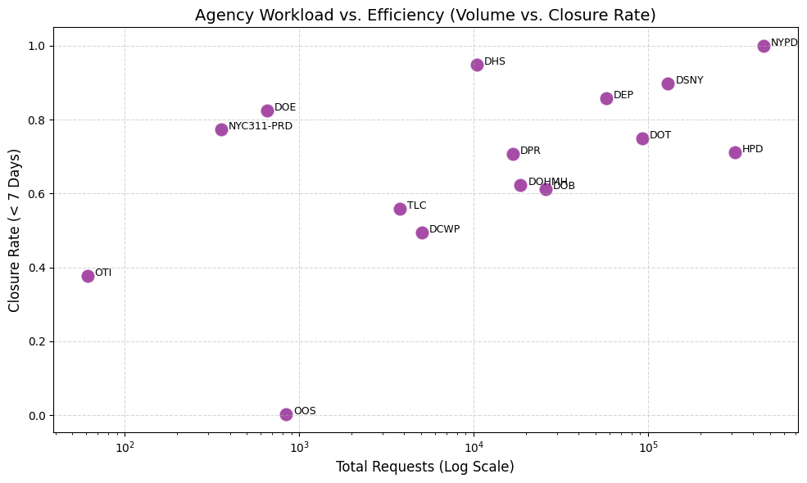
Exploratory Data Analysis
Evaluated closure rate distributions across NYC 311 requests
Compared resolution performance by borough and complaint category
Identified operational patterns linked to delayed request resolution
Explored variables most relevant to predicting 7 day closure outcomes

Slide 6
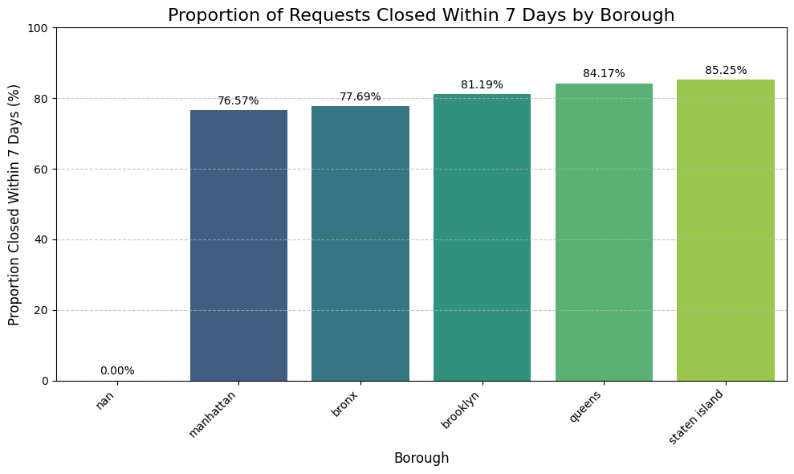
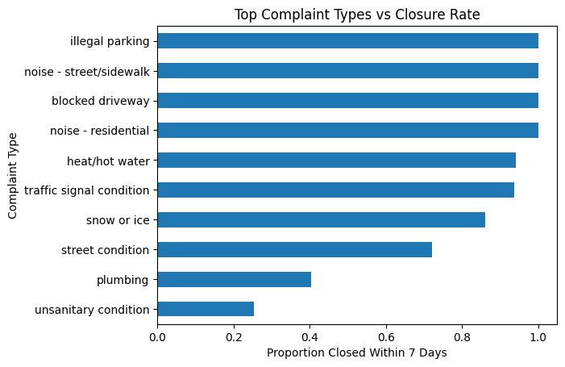
Key EDA Findings
Closure rates varied across NYC boroughs
Staten Island and Queens showed higher closure performance
Complaint type strongly affected resolution speed
Infrastructure and sanitation complaints had longer delays

Slide 7


Data mining method description
Our outcome is binary: each request either closed within 7 days or did not.
Classification fits the research question: we are predicting a Yes/No outcome, not a continuous number of days.
We tested multiple models to compare simple, interpretable methods with more flexible machine learning methods.
Logistic Regression provided interpretability by showing how predictors such as complaint type, agency, borough, and time affect the probability of timely closure
Decision Tree, Random Forest, and KNN helped test whether more complex patterns improved prediction beyond the baseline model.
1
2
3
4
5

Slide 8
📊 Model Evaluation Methods
📋 Evaluation Metrics
F1
Why F1-Score?
⚡ Accuracy
Overall correct predictions
Dataset is imbalanced
Accuracy alone is misleading on skewed data
⚠️
🎯 Precision
Positive predictive value
Balances precision and recall
Captures both false positives and false negatives
🔍 Recall
Sensitivity / true positive rate
⚖️
⭐ F1-Score
Harmonic mean of precision & recall
Primary comparison metric
Used to rank and select the best-performing model
🔄 3-Fold CV
Robust performance estimation
🏆
🧠 Train Model → 📊 Test Model → 🔄 Cross-Validation → 🎯 Compare Metrics

Slide 9
📈 Cross-Validation Results & Best Model
🏆 Key Findings
Model
⚡ CV Accuracy
🎯 CV Precision
🔍 CV Recall
⭐ CV F1-Score
Logistic Regression
0.901
0.940
0.944
0.942 ★
🏆
Logistic Regression achieved the highest CV F1-score (0.942)
Random Forest produced the highest recall (0.990)
KNN
0.889
0.928
0.942
0.935
Decision Tree provided strong interpretability
Decision Tree
0.890
0.925
0.949
0.937
KNN performed competitively but used sampled data
Random Forest
0.866
0.871
0.990
0.927
Logistic Regression selected as the best overall model
✅ Best Model: Logistic Regression | F1-Score: 0.942 | Selected for Deployment

Slide 10
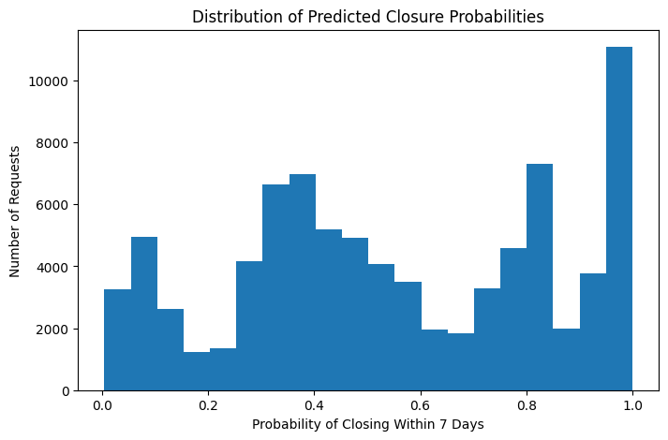
Final Predictive Results
Conducted a second EDA on the final prediction dataset
Analyzed model outputs rather than historical request data
Evaluated predicted closure outcomes and probability distributions
Identified operational patterns associated with unresolved requests
Translated model predictions into actionable service insights
Predicted closure probabilities varied across requests, indicating that the model captured meaningful differences in resolution likelihood across NYC 311 cases.

Slide 11
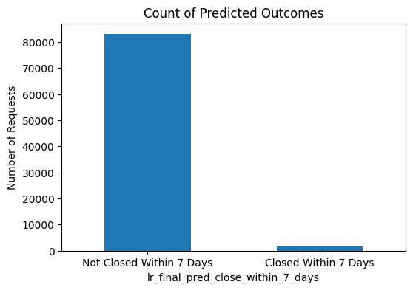
Final Predictive Results
Most requests were predicted not to close within 7 days
Delayed resolution appeared common across NYC 311 requests
Prediction patterns aligned with earlier EDA findings
Results highlighted ongoing operational inefficiency

Slide 12



Practical implications
Better resident expectations: NYC311 could estimate whether a request is likely to close within 7 days.
Identify service delays: agencies can see which complaint types or boroughs are less likely to close quickly.
Improve resource planning: staff and resources can be directed toward slower request categories.
Support process improvements: agencies can review workflows where delays are common.
Monitor service fairness: differences across boroughs can help flag potential service gaps.
1
2
3
4
5

Slide 13
Thank you!
Questions?
Dataset:https://data.cityofnewyork.us/Social-Services/311-Service-Requests-from-2020-to-Present/erm2-nwe9/about_data

